Slide 2
Attendance Hub Module 3: Structure, Roles and Responsibilities 3 October 2024
'NEC ASPERA TERRENT'
'hardships do not deter us'

Slide 3
Housekeeping and Expectations
Expectations for hub partner schools and lead school
The sessions will be recorded due to serval open evenings running this evening across our Hub
Questions posted into the chat. There will be a chance to answer at pause points
attendancehub@draytonmanorhighschool.co.uk
Resources can be found here: https://www.draytonmanorhighschool.co.uk/school-resources.php
Please ensure your webcams are on to allow for full participation but your microphones muted
Date of next meeting: Thursday 28 November
Notes:
A kind reminder of our expectations.
We already have our next meeting booked in for Thursday 28 November – we will email you reminders building up to that day.

Slide 4
DMHS Attendance Hub
A strong culture of attending school
1. Value of attendance
2. Partnerships
3. Structure
4. Data and Systems
5. Effective Interventions
6. Quality Assurance
Notes:
Just a reminder about our bespoke programme that we will be covering over the remaining 5 months. We have broken down each aspect of attendance into these modules where there will be some overlap between each but we hope this will support you in your setting in creating discussion and hopefully bettering school attendance
I would just like to take this moment to say that we are all facing a challenge around attendance – including us. The most important part of our work with attendance has been to not stand still on any of these areas but to rigorously review and implement changes to ensure that what we are doing when it comes to attendance is working and making a difference.

Slide 5
How we work as a leadership team
CRAVE Leadership: Whatever we turn our attention to, it gets better
Clarity – be clear on who is leading
Reflection – autopsy without blame
Accountability – define what needs improving and how it will be measured
Values – do what is right for our students, not easy
Expertise – go seek out advice, adapt current practice and act
Notes:
As always, as attendance leads on our call – we will be thinking closely about our systems and practices around attendance with our CRAVE school improvement hat on. We find this model works best when reviewing what we do and how we could do it better

Slide 6
 | Student | Staff | Parents
Pre-DMHS | Y6 Summer school to set the high attending culture Year 6 students invited to summer show Each student spoken to during primary school visits | Safeguarding training includes responsibility for safeguarding Knowing the law and guidance Training for staff in attendance roles Analysis of Year 6 EWO data | Year 6 parent meetings Year 7 welcome event in first week
Daily | All late students reflect on why they are late on arrival with a member of SLT Detentions for one off lates Next day Tutor/HOY conversation with returning absent students Free breakfast available each day Nurture breakfast for selected EBSA students Return to school meetings Pre-emptive 8am phone calls | Dedicated SLT Attendance lead – strategy, leadership and data sharing Attendance systems work schedule and daily, termly checklists Everyone responsible for attendance Extended opening hours: library, music practice rooms, basketball courts SLT walk the local community each morning and afternoon | First day absence call and expectation to name return time/date Parents phoned for each late Access attendance percentage on school app
Notes:
Here we have mapped everything that students, staff and parents (key stake holders) do to ensure good school attendance. We will be focusing today a lot on the pre-secondary school work that goes on at Drayton Manor High School to ensure a successful start for each year 7 child. We will also be focusing in on the role of the parent today and the important relationship that school has to maintain with parents
Today, we will be discussing how we have systemized much of the above

Slide 7
 | Student | Staff | Parents
Weekly | Escalating sanctions for persistent lates Weekly attendance tracking in student planner and form group Attendance mentoring Challenge 96 tutor programme | Attendance support interventions and referrals for each PA/SA | Tiered warning letters for poor attenders Each PA/SA attendance contract meeting Weekly parent bulletin with advice on attendance
Termly/ Annually | End of term celebration for high attenders Celebration breakfast Celebration texts and merits Attendance standards assembly | Attendance matters/safeguarding training Attendance data linked to progress data Reward letters home Extensive budgeting for yearly repairs/painting of entire site | Six curriculum/pastoral parent events each academic year All students written to below 96% warned about low levels of attendance Year group parent success evenings Parents evening

Slide 8
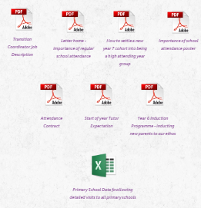
The Resource Page
SCHOOL RESOURCES (draytonmanorhighschool.co.uk)
Notes:
Please be reminded about checking the attendance hub page. For example, the drop down for module three will contain the documents that are referenced today. Please download, reuse in your context and let us know in the next module your successes.

Slide 9
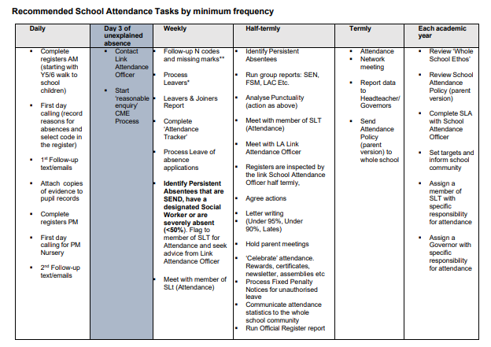
Resources From This Module
Governor Attendance Report Template
Attendance Responsibility Checklist
Protocol for late to school
Head of Year duty for late to school
Lateness reflection sheet
Daily, weekly, monthly attendance tasks
https://www.draytonmanorhighschool.co.uk/school-resources.php

Slide 10
Feedback
Key question:
Have you made changes to your practice around school attendance since the last hub session?
How do you know the new changes have worked?
How have the updated attendance guidelines changed your practice?
Write into the chat your suggestions – 3 minutes
Notes:
So we just wanted to take a moment today to reflect on progress made since our last meeting.
Please could you take a moment to post into the chat explaining any changes you have made since the last session and any impact that you have seen? How do you know the new changes have worked?
Have you found that you have adapted your systems due to the new guidance?

Slide 11
Welcome to module 3:
To explain how attendance is structured at Drayton Manor High School – specifically roles and responsibilities
Provide an update on changes to Working Together to Improve School Attendance
The 'Cogs' of building good attendance
Notes:
In this session, we will:
Explore how attendance is structured at Drayton Manor High School – specifically roles and responsibilities
This will include topics on:
SLT structure – attendance lead and link with safeguarding, data, teaching and learning
Reports and scrutiny from assigned Governor/Trustee
Task lists/ job responsibilities of attendance team/student reception
Training – shadowing opportunities/ policy/ knowing the law
Data schedule/ SLT weekly review - Role of tutors/HOY/Deputy HOY
Attendance/pastoral team role including innovative ‘return to school/work’ meetings
School Calendar setting and use of occasional days and INSET
Annual review of structures: staffing
Termly review of structures – querying what is the impact
How to develop capacity
Staff development and support

Slide 12
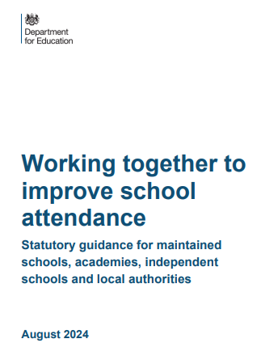
Notes From The Updated Guidance
Changes in coding, national framework, fines and early help
Compulsory sharing of attendance data through WONDE
Changes we have already implemented
Policy updates
Notice to improve requirement
Record keeping
Notes:
Big changes for 2024 – statutory and has had implications for our ways of working
Early help is first and key. National media have picked up on fines but this is not the focus of the updates
Things to be aware of:
Important to update the policy
Inform parents of new notice to improve meetings/ conversations
Changes to the fines
Attendance data being shared
We are able to share our updated attendance policy with you which has included the updated guidance

Slide 13
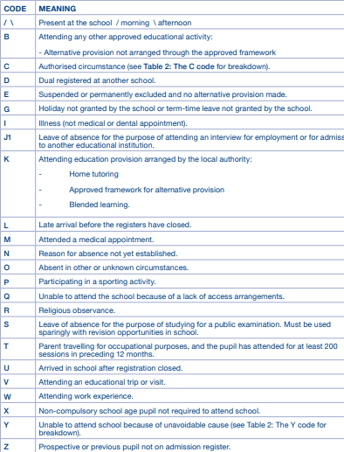
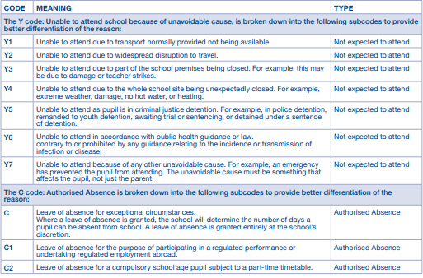
Updated Attendance Codes
Notes:
K vs D – seeking clarity on this
J1 code – now authorized absence – careful consideration around year 11 interview absence
B code: cannot be used for online education
T code – wider scope
Range of Y codes – Y7 in focus and case studies on this
C2 code – part time timetable

Slide 14
Early Help and Notice to Improve
Year 6 data
Logging attendance calls
Year 7 notice to improve calls
New parental letter: notice to improve
Threshold for EWO and evidencing this
Notes:
Early help a key part of new guidance
Notice to improve – sharing this language with parents. Informing that attendance is shared with LA
10 sessions in 10 weeks – possibility of a fine – important to work with the school to avoid this

Slide 15
Our Attendance Structure
Governor and SLT
Pastoral Manager
Head of Year
Deputy HOY
Form Tutor
Attendance Officer
Attendance Welfare Officer
Classroom Teachers
Inclusion Faculty
Communications
Notes:
Welcome to our structure
CRAVE
Clarity
Reflection – autopsy without blame
Accountability – define what needs improving and how it will be measured
Values – do what is right for our students, not easy
Expertise – go seek out advice, adapt current practice and act

Slide 16
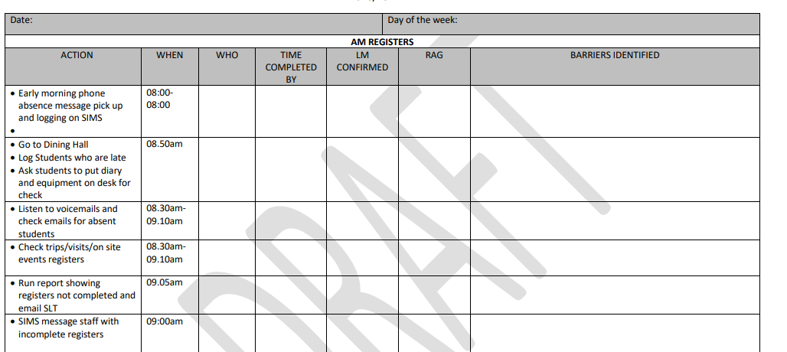
The Attendance Officer
Importance of professional curiosity
Streamline of tasks
Golden Hours
Support/ Team around the officer
Structure of the day
Morning: data logging and follow up
Afternoon: formal follow up and referrals/ quality assurance

Slide 17
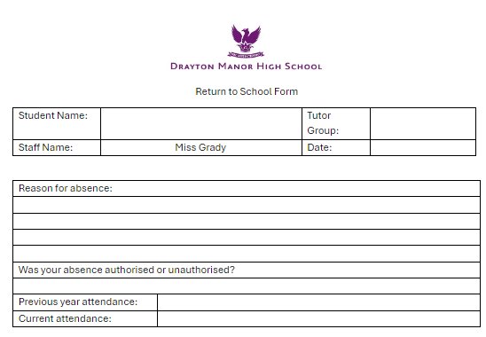
Attendance Welfare Officer
New position for DMHS
Return to school meetings
Attendance Mentoring
Early morning calls
Follow up

Slide 18
Communications Officer
Whole school letters
Having the right system
Dynamic letters
Evidencing support
Nudge Texts
Bank of go to communication ideas
Start of term/End of term communications

Slide 19
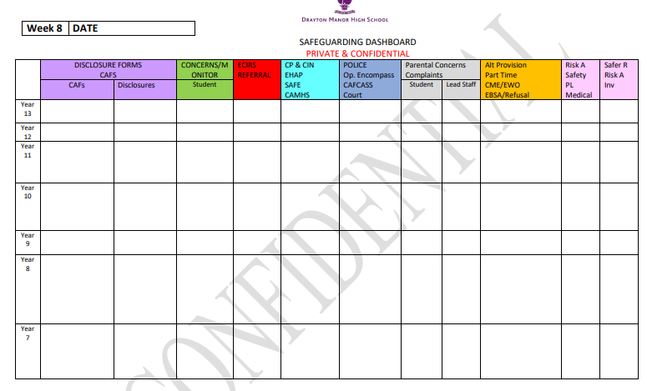
Pastoral Manager
Pulling together the team
Information sharing
Monitor cases

Slide 20
Pause Point
Who is the team around your attendance officer?
How do you review the coding choices of your attendance officer?
What measures do you take to communicate the importance of good attendance

Slide 21
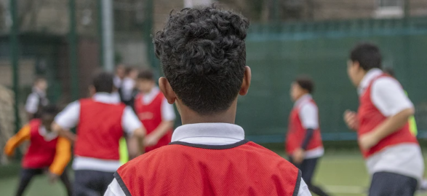
Inclusion Faculty
Bespoke support for EBSA
Use of part time timetables
Regular review points taking on board parental and student views
Safe space in school to support with anxiety
Notes:
Lead professionals

Slide 22
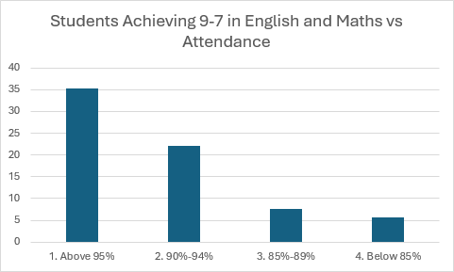
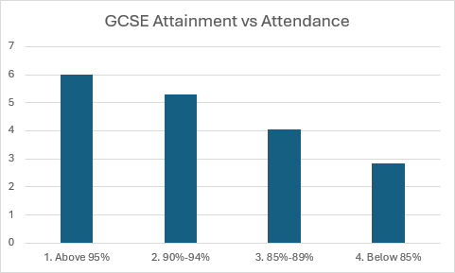
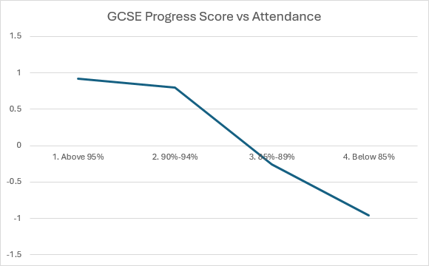
Classroom Teacher
Sharing the link of results and attendance in their subject
High challenge for missed work
Referral to homework club for missed learning
Notes:
Impowering them to have difficult conversations about attendance
Same attitude as everyone is responsible for safeguarding

Slide 23
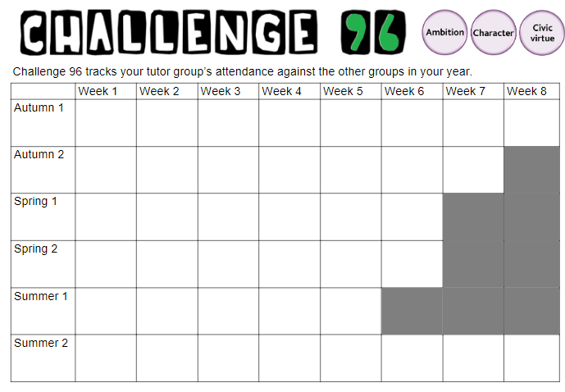
Form Tutor
End of desk conversations
Responsibility for encouragement of tutor attendance through challenge 96 programme
Expectation to support with phone calls home as directed by HOY
Notes:
Warm welcomes
Involved in attendance calls
We missed you yesterday

Slide 24
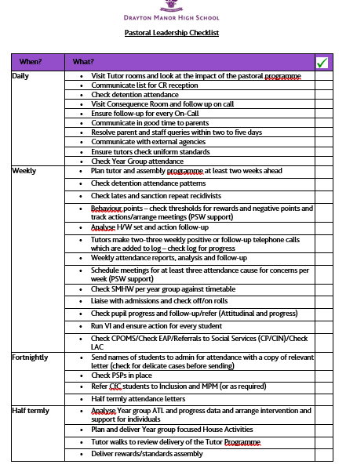
Head of Year and Deputy
Lead on year group attendance
Proactive encouragement
Early help through directing tutor phone calls
Attendance contract meetings
Providing evidence for EWO referrals
Lead on medical alternative provision referrals
Notes:
Clear involvement in attendance
Can share this checklist with you
Attendance policy details out the roles of each person – we have found this useful and to also include parents

Slide 25
SLT
SLT link for each year group
Daily reporting of year group attendance figure, absent students, coding and late students
Weekly attendance bulletin with trends identified
CRAVE leadership

Slide 26
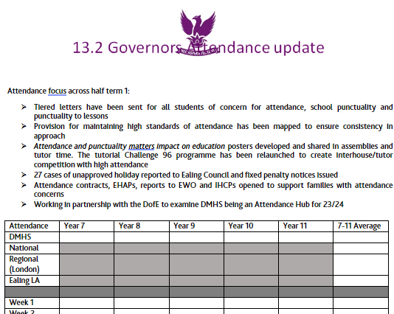
Link Governor
Half termly reporting
Trends in data reported
Reporting on comparison to last year, LA and National data
Notes:
Schools BI

Slide 27
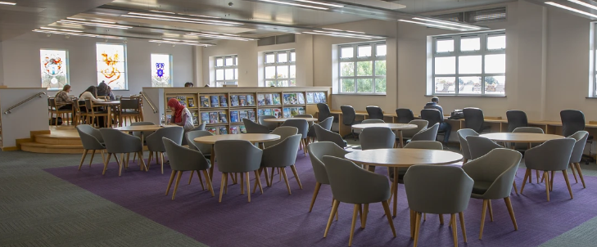
How do we Review – Is It Working?
Every level of leadership involved in review
Tracking with data – is there improvement?
Quality assurance schedule – more to follow in session 6

Slide 28
Discussion Points
What training schedule/ providers have you used for training key members of staff on attendance?
How do you ensure that attendance is on the agenda for all levels in the organisation?
How have you tried to streamline the roles and responsibilities of key staff to ensure they are completing high impact interventions?

Slide 29
DMHS Attendance Hub
A strong culture of attending school
1. Value of attendance
2. Partnerships
3. Structure
4. Data and Systems
5. Effective Interventions
6. Quality Assurance
Module 4 is now open to access on the Hub resource webpage
We look forward to seeing you in November for module 4: Data and systems
Notes:
I hope you have enjoyed the session today. We will be emailing out further information about the next session in November. If there are any staffing changes and we need to update the contact details for the attendance lead, please do email us at attendancehub@draytonmanorhighschool.co.uk
Thank you again for joining us and I hope this busy term goes well! See you all soon.

