Slide 1
How do we support learning at Drayton Manor High School?
'NEC ASPERA TERRENT'
'hardships do not deter us'
Robert Johnston
Assistant Head, Teaching & Learning

Slide 2
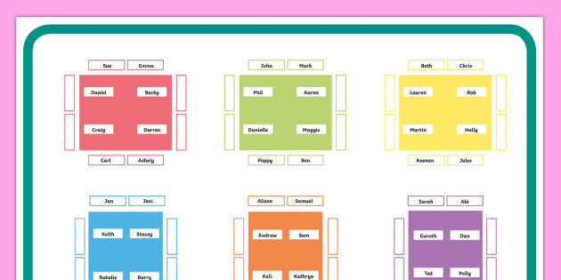
It’s all in the planning…
Seating plans
Curriculum Design

Slide 3
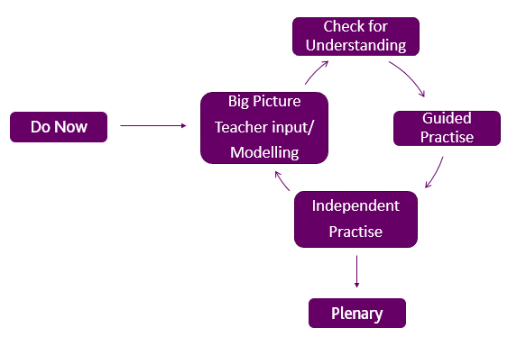
The Learning Sequence

Slide 4
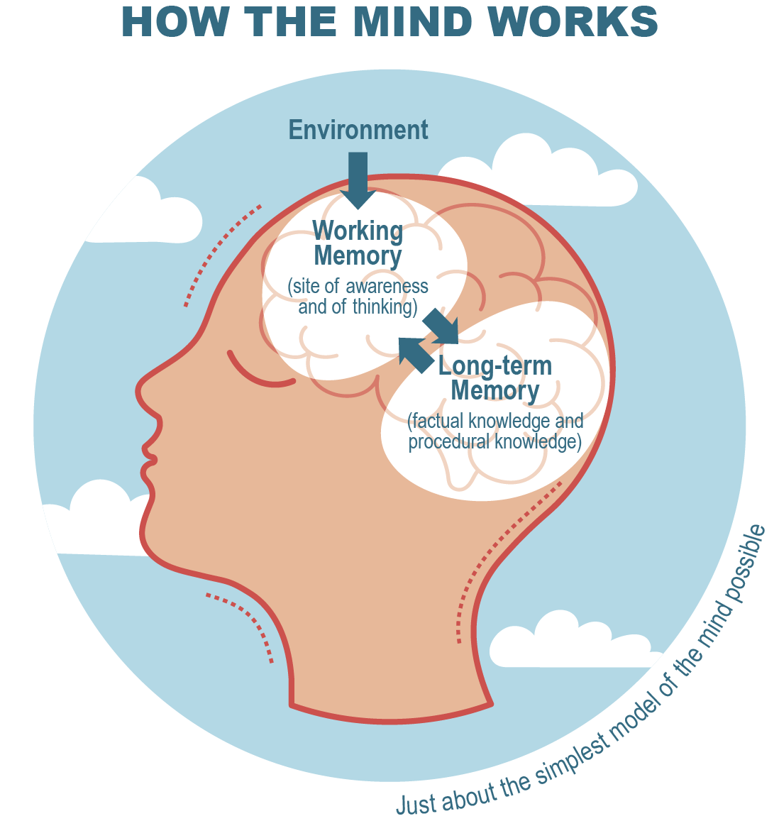
Making it ‘Stick’
What is deep, meaningful and long lasting learning?
Working memory and long term memory
Simple Exercise (use only your mind!)
Can you work out 4 x 9?
Now try 13 x 6
Now try 23 x 47
Why does it get harder?

Slide 5
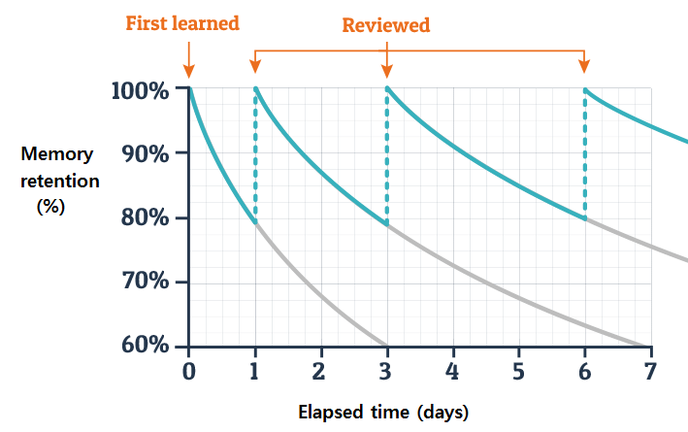
Making it ‘Stick’
BUT, no matter what, we still forget…
Must regularly review previously learned material
Building ‘retrieval strength’
‘Interleave’ past topics into current ones
Increases the likelihood of long term retention

Slide 6
At the Start of Lessons we all… Do Now
Year 11 Chemistry Do Now
State the number of protons, neutrons and electrons in a sodium atom
What about a sodium ion?
Explain why diamond is hard
Under what conditions will sodium chloride conduct electricity
Give two examples of an exothermic reaction
Write a method to determine the volume of carbon dioxide evolved from the reaction of HCl and 1g of magnesium carbonate

Slide 7
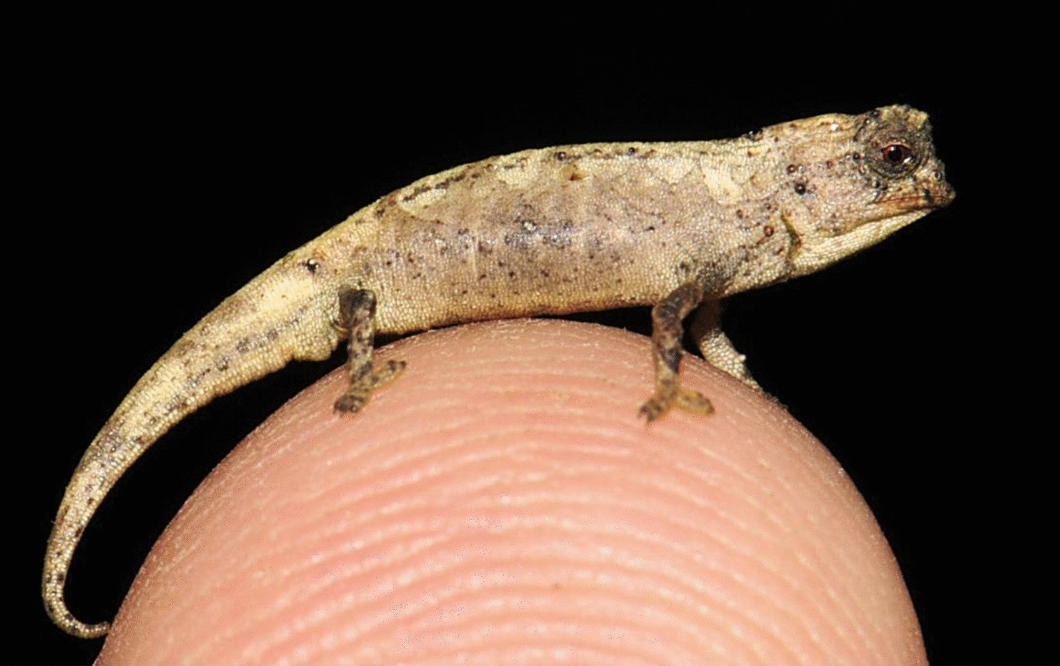
We explain/model things and link them to life…But why?
What is this creature?
How do you know?

Slide 8
We check that everyone gets it…
The difference between ‘I taught it’ and ‘they learned it’
Teachers will:
Pose questions to the whole class and make all students think before giving an answer
Use multiple choice questions that include plausible answers
Push students to elaborate on their answers – full sentences please
Use mini white boards so students can write down their thoughts rather than verbalising them
Let students discuss with a peer to build confidence

Slide 9
We make students practice and observe what they do
Does practice make perfect?
To my mind, no. Rather, practice:
Consolidates learning
Builds fluency in a skill/new knowledge
Helps students work towards mastery
Builds character
Value effort

Slide 10
Homework
To consolidate learning or stretch new skills
Once a week in each subject (apart from a small number which are fortnightly)

Slide 11
Questions
'NEC ASPERA TERRENT'
'hardships do not deter us'

