Slide 1
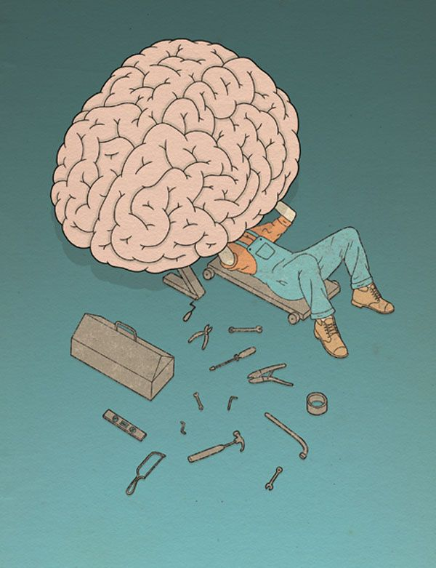
Psychology Bridging Menu
You are about to start an exciting journey into the world of Psychology where you will learn about the scientific study of the mind and behaviour!
Remember:
Choose what modules you do and when, but work through them consistently. Different tasks will take you varying amounts of time, but on average you should aim to do one or two per week.
All green tasks are core modules, they are compulsory and must be completed.
The red hot chili indicates that the task is more challenging than the others.
Numbers e.g. (1) correspond to how you should evidence the module which can be found in the slides following the menu.

Slide 2
Psychology Bridging Menu (Green modules are core (compulsory) modules , indicates the most challenging modules)
Read | Watch | Listen | Visit (virtually or physically) | Do
The man who mistook his wife for a hat – Oliver Sacks (1) A collection of studies detailing the most bizarre neurological disorders resulting from damage to the brain. | A beautiful mind (Movie) (1) A brilliant mathematician becomes entangled in a conspiracy – a winner of 4 Oscars. | An introduction to Psychology (9) This free online course provides all new AQA A-Level Psychology students with a useful introduction to the structure of their course and how students are assessed. | Explore the brain (4) Explore the interactive brain to learn about its structures and functions. | Starting with psychology The greatest puzzle we face is ourselves. Psychologists put forward a range of explanations about why people feel, think and behave the way they do. It is not easy to pin down all the many influences but this free course makes a start. (5)
Opening Skinner's Box: Great Psychological Experiments of the Twentieth Century (1) Slater takes us from deep empathy with Stanley Milgram's obedience subjects to a disturbing re-creation of an experiment questioning the validity of psychiatric diagnosis. | The Stanford Prison Experiment (Movie) (1) The controversial psychology experiment in which college students pretend to be prisoners and guards, but the proceedings soon get out of hand. | Joseph Wolpe and Systematic Desensitization (1) Joseph Wolpe's treatment for phobias can be seen as the foundation for today's cognitive behaviour therapy used to treat many mental health conditions. | The open university (5) – complete one of the following free online Psychology courses: Forensic Psychology An introduction to cognitive psychology Young people and their mental health Understanding Anxiety, Depression and CBT Attachment Obedience and ethics
 |  |  |  | Are criminals born or made? (7) Research and produce an essay on the above question.
 |  |  |  | Research one of the Psychological approaches listed below and produce a presentation which covers: The main assumptions of the approach The key concepts of the approach The research methods used by the approach The contributions of the approach The strength and limitations of the approach Psychological approaches: The Psychodynamic approach The behaviourist approach The humanistic approach The cognitive approach Social learning theory The biological approach (8)
The Lucifer Effect: How Good People Turn Evil (1) Psychologist Philip Zimbardo challenges our conceptions of who we think we are and what we believe we will never do. | TED Talks (1) 9 myths about psychology, debunked How reliable is your memory? The Psychology of evil | The Bobo Doll (1) Bandura's ground-breaking Bobo Doll experiment exposed the dangers of imitation. |  | Research one of the Psychological approaches listed below and produce a presentation which covers: The main assumptions of the approach The key concepts of the approach The research methods used by the approach The contributions of the approach The strength and limitations of the approach Psychological approaches: The Psychodynamic approach The behaviourist approach The humanistic approach The cognitive approach Social learning theory The biological approach (4)
 |  | Case Study: HM - The Man Who Couldn't Remember (1) Having lost his own memory, HM revealed how new memories are formed.
Elephants on Acid (1) The craziest psychological experiments. | Crash Course Psychology (2) A playlist of informative videos.
The Little Book of Psychology: An Introduction to the Key Psychologists and Theories You Need to Know (1) An introduction to the key thinkers, themes and theories in Psychology. | Three identical strangers (3) Identical triplets separated at birth reunite and unearth an unimaginable secret that has radical repercussions. | The Boy Raised as a Girl (1) For decades the John/Joan case ‘proved’ that nurture dictates gender identity. In fact, the case was not a success and hid a personal tragedy. | Bethlehem Museum of the Mind (6) (Virtual work available) Explore the history of mental healthcare and create your own art work inspired by past patients of Bethlehem Hospital – the UK’s oldest residential psychiatric hospital.
The Psychology Book (1) The Psychology Book is your visual guide to the complex and fascinating world of human behaviour. | The Brain with David Eagleman - What Is Reality (1) Dr David Eagleman explores how the brain, locked in silence and darkness, conjures up the world we all take for granted.
 |  | Case Study: The Man with a Hole in His Head (1) Phineas Gage survived a bizarre accident that changed him - and the study of neuroscience.
 |  |  | Freud Museum London (1) The home of Freud, the founder of psychoanalysis.

Slide 3
(1) - Book/Journal/Podcast/Film/Visit Review
Would you/would you not recommend it? Why?
Rating:
Review by: ___________________________________________
Title: _______________________________________________________
Author: ____________________________________________________
Review of (please circle)
Book Journal Podcast Film Documentary
What was it about?
What did you find particularly interesting/inspiring/shocking? Has this changed your opinion?
What would you like to learn more about?
How does it link to this subject and why is it important?

Slide 4
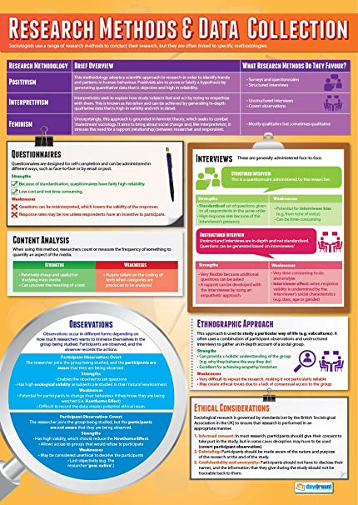
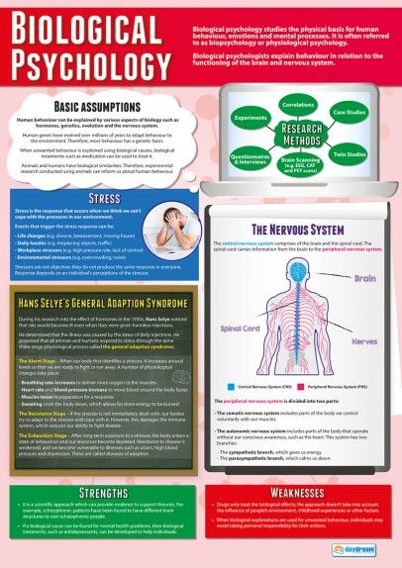
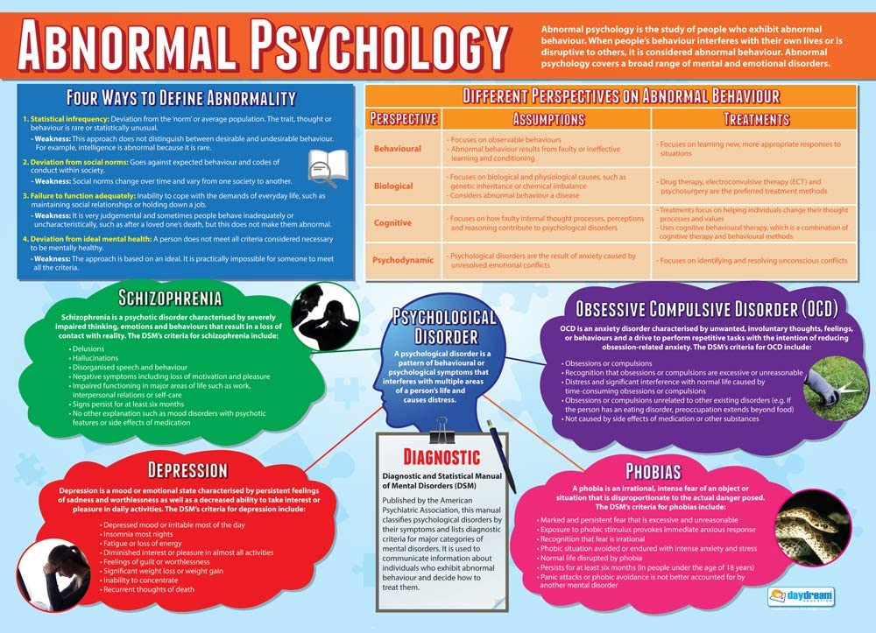
(2) Crash Course Psychology
Select at least three of the videos in the playlist that most interest you (you are always encouraged to watch more!)
Produce a creative and informative poster on each of the videos you selected. This must include:
An overview of the topic i.e. what you learned.
Key terminology for the topic
Pictures should be used to make your poster engaging and easy to understand.

Slide 5
(3) Three identical strangers documentary
Answer the following questions regarding the documentary:
Describe what happened to the triplets and how their upbringing differed.
Define the nature vs nurture debate and explain how can it be applied to the story of the triplets.
Twins are often used in psychological research to determine whether we are born a particular way (due to our genes) or whether our behaviour is caused by our environmental experiences. Identify any of the triplets’ behaviour that was due to their genetics (nature) and any of their behaviour that was due to their environments (nurture).
All three were adopted through the Louise Wise Services Adoption Agency. Describe the circumstances of their adoption and what ethical implications there are from this.
Nature | Nurture

Slide 6
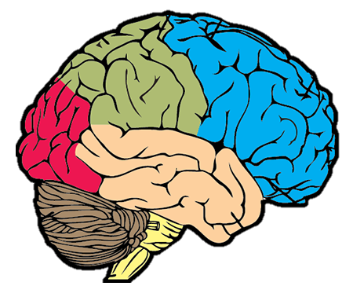
(4) The Virtual brain
Use the interactive brain model to fill in the diagram below:
Name of lobe: Parietal lobe
Function:
Consequence if damaged:
Name of lobe: Occipital lobe
Function:
Consequence if damaged:
Name of lobe: Frontal lobe
Function:
Consequence if damaged:
Name of lobe: Temporal lobe
Function:
Consequence if damaged:
Name of structure: Cerebellum
Function:
Consequence if damaged:

Slide 7
(5) Starting with Psychology / The Open University
To evidence your completion of the course(s) you must:
Write down notes
Take a picture of your statement of participation certificate that you gain on completion.

Slide 8
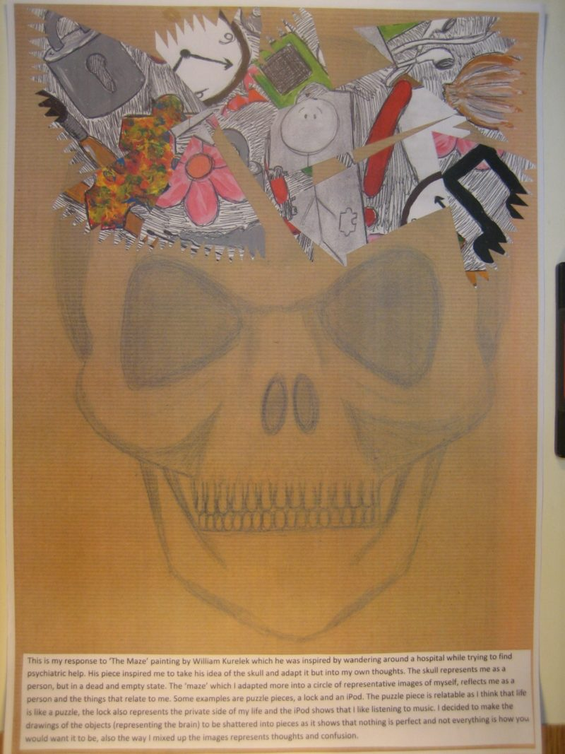
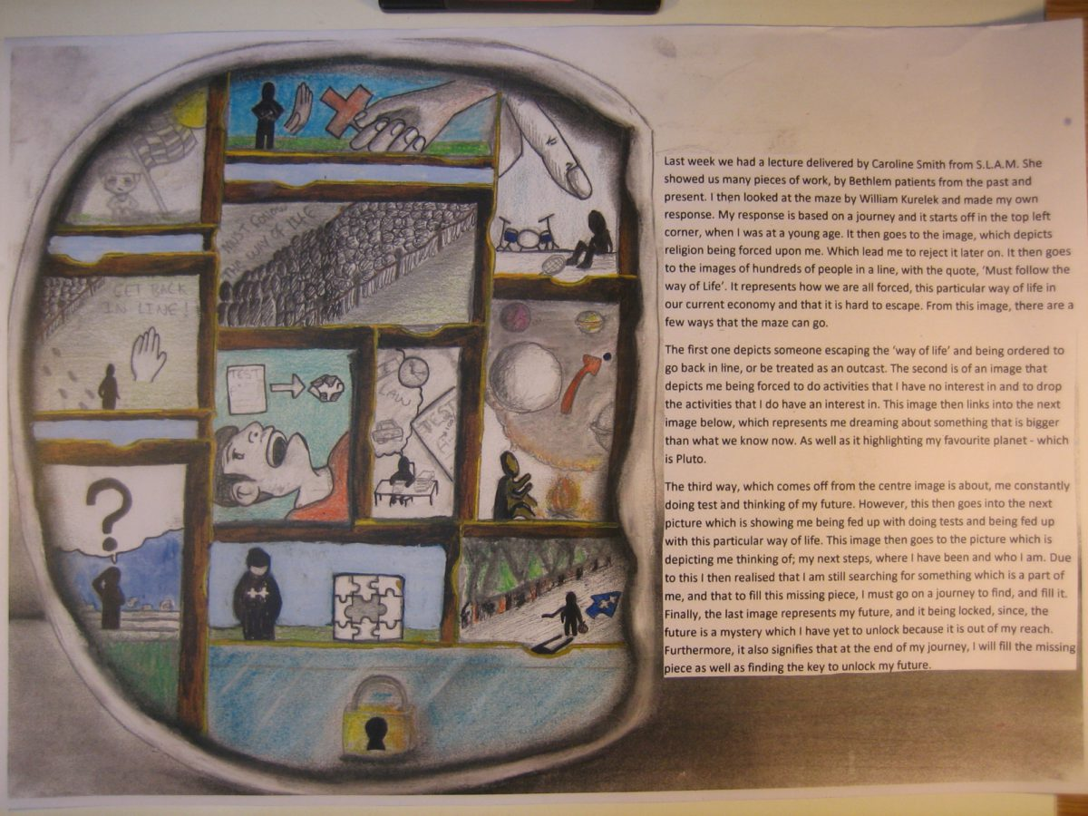
(6) Bethlehem Museum of the mind
It may be difficult to visit the Bethlehem Museum of the mind in person. However, you can look at some of the art work online. Follow the link below to read about William Kurelek’s autobiographical painting ‘The Maze’ which was painted when he was 26 and a patient at Bethlem’s sister hospital The Maudsley:
https://museumofthemind.org.uk/learning/the-maze
Once you had analysed the meaning behind the art, use it as inspiration to create your own piece of art representing your life. You must also write a summary of the meaning behind your art. Below are some examples of students’ work inspired by The Maze. You can read about the meaning behind them by clicking the images.

Slide 9
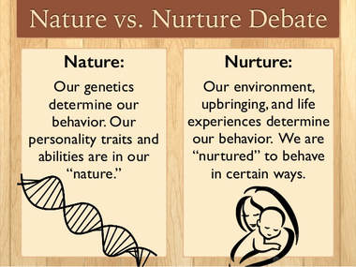
(7) Are criminals born or made?
Research and produce an essay on the following question: ‘Are criminals born or made?’
You must weigh up the arguments from the nature perspective (that argues criminality is caused by genetics, brain abnormalities etc) as well as the nurture perspective (that argues criminality is caused by environmental experiences e.g. a history of abuse) and come to a conclusion.
You should use examples of famous criminals (e.g. Ted Bundy) to support your discussion.
You could use research evidence to support either side of the debate.
Some links to help your research on this topic:
https://www.youtube.com/watch?v=u2V0vOFexY4
https://www.bbc.co.uk/news/magazine-31714853
https://www.independent.co.uk/news/uk/do-your-genes-make-you-a-criminal-1572714.html
http://www.laurahamlett.com/blog/ted-bundy-nature-vs-nurture/
https://www.youtube.com/watch?v=MJ7Zl4j911Q

Slide 10
(8) Presentation on a psychological approach
An approach is a perspective (i.e., view) that involves certain assumptions (i.e., beliefs) about human behaviour: how it should be explained, which aspects of behaviour are important to study, and what research methods are appropriate for undertaking this study.
1) Research one of the following approaches in Psychology:
The Psychodynamic approach
The behaviourist approach
The humanistic approach
The cognitive approach
Social learning theory
The biological approach
2) Create an information sheet/powerpoint presentation on your approach. You must have a separate slide/section dedicated to each of the following points:
The main assumptions of the approach
The key concepts of the approach
The research methods used by the approach
The contributions of the approach
The strength and limitations of the approach

Slide 11
(9) An introduction to Psychology
Make notes on the AQA A-level Psychology course. This must include:
What are the assessment objectives?
How will you be assessed?
What skills will Psychology require?
What mathematical skills will you need? (If there are any you are not confident with, go over these!)

